Slide 1
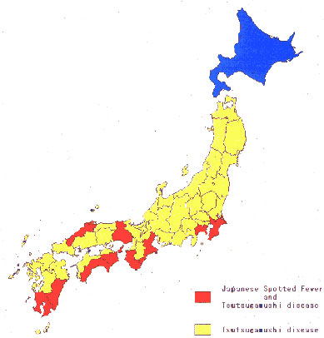
Figure 5
Figure 5.&nbsp;Geographic distributions of JSF and Tsutsugamushi disease in Japan.
Mahara F. Japanese Spotted Fever: Report of 31 Cases and Review of the Literature. Emerg Infect Dis. 1997;3(2):105-111. https://doi.org/10.3201/eid0302.970203

