Slide 1
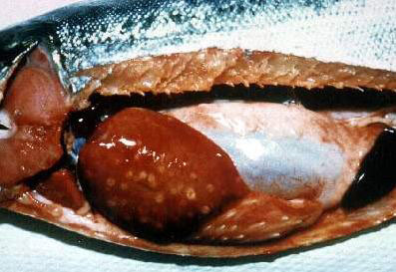
Figure 4
Figure 4.&nbsp;Coho salmon infected with Piscirickettsia salmonis. Note cream- colored lesions on liver, enlarged spleen, pale gills, and hemorrhaged areas within the peritoneal cavity.
Fryer JL, Mauel MJ. The Rickettsia: an Emerging Group of Pathogens in Fish. Emerg Infect Dis. 1997;3(2):137-144. https://doi.org/10.3201/eid0302.970206

