Slide 1
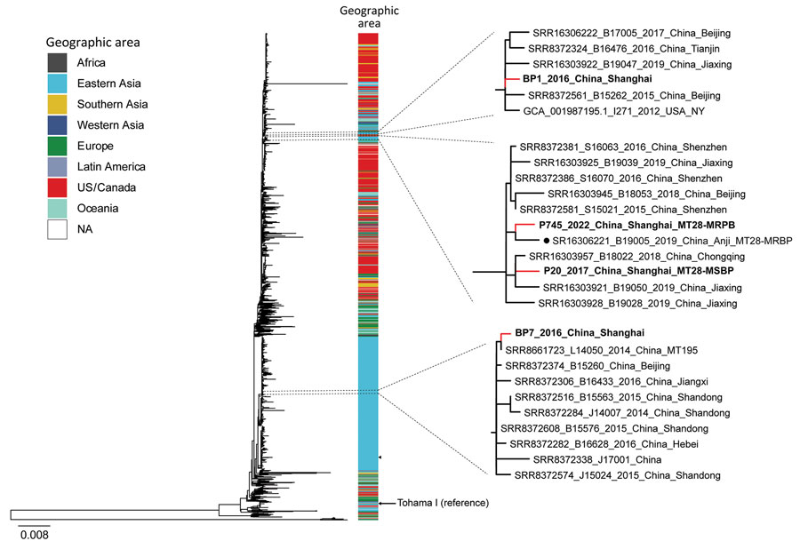
Figure 5
Figure 5. Maximum-likelihood phylogenetic tree of 4 Shanghai, China, and 1,491 global Bordetella pertussis strains, by geographic area, 2016–2022. Red lines indicate Shanghai strains; bold indicates 2 MT28 strains. Black dot indicates MT28-MRBP (B19005) strain from Anhui Province, China. Arrow indicates reference strain Tohama I. Shanghai strains associated phylogenetic subclades are enlarged for visualization. MSBP, macrolide-sensitive Bordetella pertussis; MT, multilocus variable-number tandem-repeat analysis type; NA, not applicable.
Fu P, Zhou J, Yang C, Nijiati Y, Zhou L, Yan G, et al. Molecular Evolution and Increasing Macrolide Resistance of Bordetella pertussis, Shanghai, China, 2016–2022. Emerg Infect Dis. 2024;30(1):29-38. https://doi.org/10.3201/eid3001.221588

