Slide 1
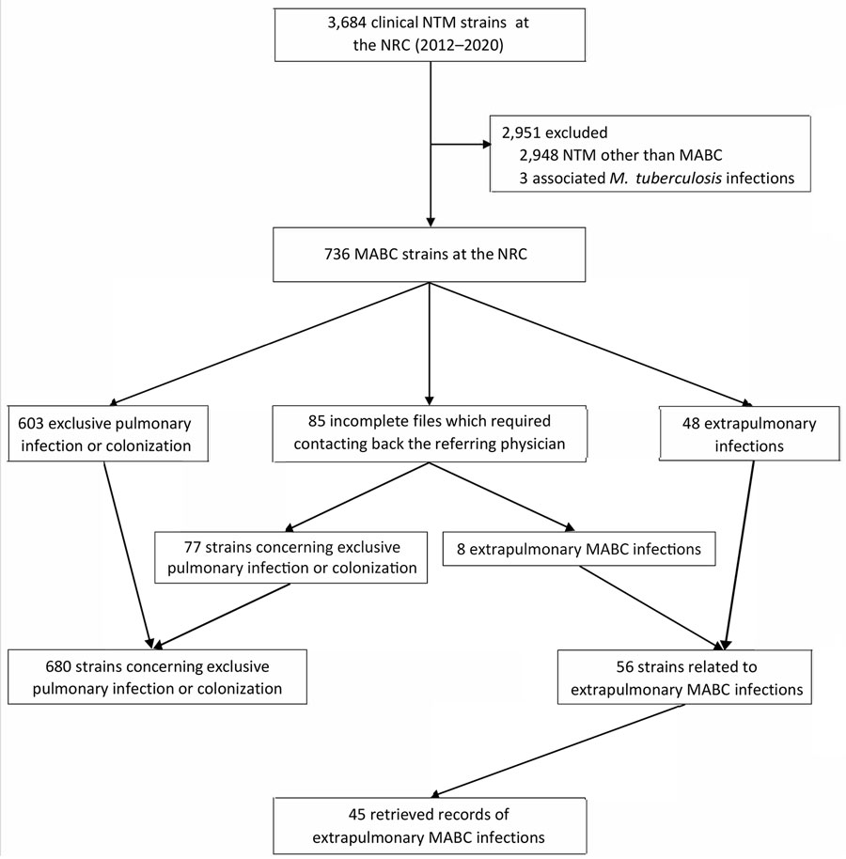
Figure 1
Figure 1. Flowchart of selection for study of extrapulmonary Mycobacterium abscessus infections, France, 2012–2020. NRC, national reference center; NTM, nontuberculous mycobacteria; MABC, Mycobacterium abscessus complex.
Heid-Picard B, Mougari F, Pouvaret A, Lanternier F, Awad Z, Bille E, et al. Extrapulmonary Mycobacterium abscessus Infections, France, 2012–2020. Emerg Infect Dis. 2024;30(11):2294-2302. https://doi.org/10.3201/eid3011.240459

