Slide 1
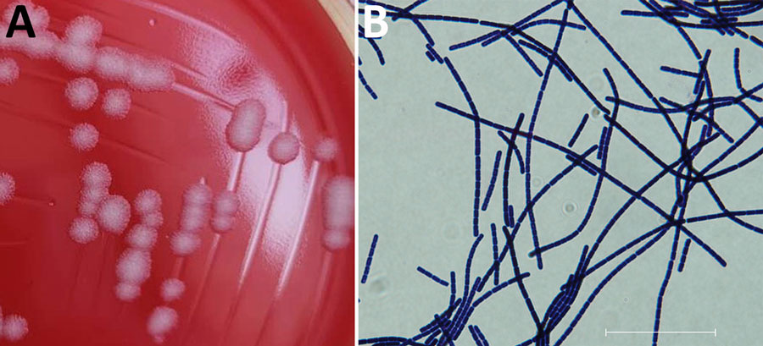
Figure
Figure. Preserved isolate from a bacteriologic and genomic investigation of Bacillus anthracis from World War II site, China. A) Morphological analysis of B. anthracis isolated on Columbia blood agar plate showing classic B. anthracis features: gray, opaque, medium sized, irregular-shaped colonies with a ground glass surface and no surrounding hemolytic rings. B) Gram staining showing B. anthracis bamboo-like arrangement. Scale bar represents 30 μm. Isolate data are available in GenBank (accession no. CPI3355587–89).
Wu Y, Yuan Y, Yuan B, Li J, Wang J, Cui Y. Bacteriologic and Genomic Investigation of Bacillus anthracis Isolated from World War II Site, China. Emerg Infect Dis. 2024;30(12):2687-2689. https://doi.org/10.3201/eid3012.231520

