Slide 1
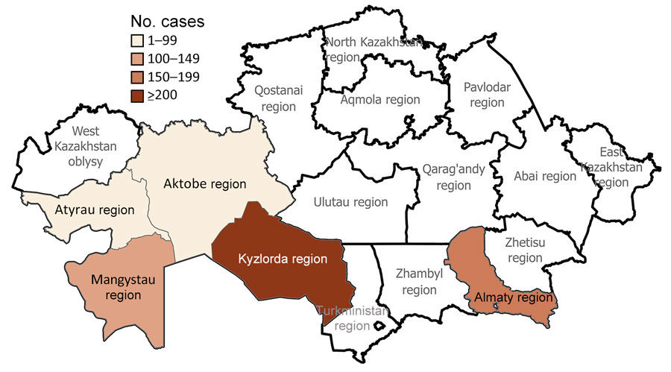
Figure 4
Figure 4. Locations of human plague cases by region in a historical assessment and mapping of human plague, Kazakhstan, 1926–2003.
Rametov N, Abdel Z, Zhumadilova Z, Yessimseit D, Abdeliyev B, Mussagaliyeva R, et al. Historical Assessment and Mapping of Human Plague, Kazakhstan, 1926–2003. Emerg Infect Dis. 2024;30(12):2483-2493. https://doi.org/10.3201/eid3012.231659

