Slide 1
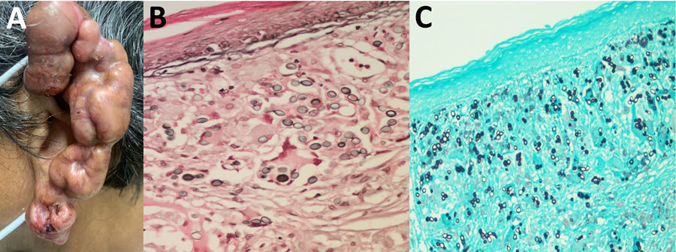
Figure 1
Figure 1. Clinical manifestations of lesions in patient with lobomycosis in Amazon Region, Bolivia, 2022. A) Multiple hyperpigmented, confluent keloid-like nodular lesions with overriding telangiectasias and patchy crusted and eroded squamous areas were noted on the helix and lobule of the left ear. B, C) Histologic examination of lesion specimens showed oval-to-round shaped cells that had connecting tubular projections organized in a string-of-pearls pattern, in pairs and individually. B) Fontana-Masson stain; original magnification ×1,000. C) Gömöri methenamine silver stain; original magnification ×400.
Méndez MI, Colanzi R, Suárez JA, Penagos H, Hernandez C, Garcia-Redondo R, et al. Lobomycosis in Amazon Region, Bolivia, 2022. Emerg Infect Dis. 2024;30(12):2660-2663. https://doi.org/10.3201/eid3012.241089

