Slide 1
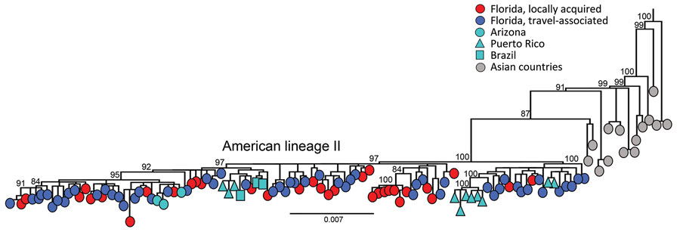
Figure 2
Figure 2. Evolutionary analysis of dengue virus serotype 3 sampled in Florida, USA, May 1, 2022–April 30, 2023. Maximum-likelihood phylogenetic tree was generated from a subset of 203 complete genomes from Florida (34 local cases, 168 cases in persons with recent travel history to Cuba, and 1 traveler case from Guyana) and 146 complete genomes publicly available (1985–2022) from GenBank representing genotype III, American lineage II. A subset of the sequences was used because of the low diversity in the population sample, which was limiting the phylogenetic signal and hampering the statistical analyses that supported the tree accuracy and certainty in major nodes. Sampling locations are coded by shape and color. Scale bar represents nucleotide substitutions per site.
Jones FK, Morrison AM, Santiago GA, Rysava K, Zimler RA, Heberlein LA, et al. Introduction and Spread of Dengue Virus 3, Florida, USA, May 2022–April 2023. Emerg Infect Dis. 2024;30(2):376-379. https://doi.org/10.3201/eid3002.231615

