Slide 1
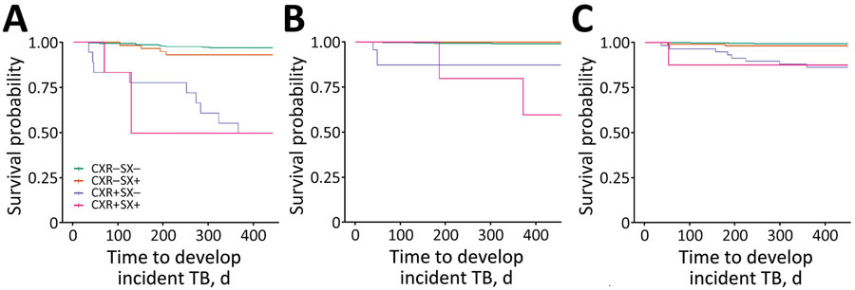
Figure 3
Figure 3. Associations between abnormal chest radiographs and time to incident TB among tuberculin skin test–positive adults in 3 age groups, Peru. A) 16–24-year age group (N = 370, incident events = 25); B) 25–44-year age group (N = 709, incident events = 13); C) &gt;45-year age group (N = 668, incident events = 14). CXR–, unremarkable chest radiograph, CXR+, abnormal chest radiograph; SX–, no symptoms; SX+, symptoms; TB, tuberculosis.
Tan Q, Huang C, Becerra MC, Calderon R, Contreras C, Lecca L, et al. Chest Radiograph Screening for Detecting Subclinical Tuberculosis in Asymptomatic Household Contacts, Peru. Emerg Infect Dis. 2024;30(6):1115-1124. https://doi.org/10.3201/eid3006.231699

