Slide 1
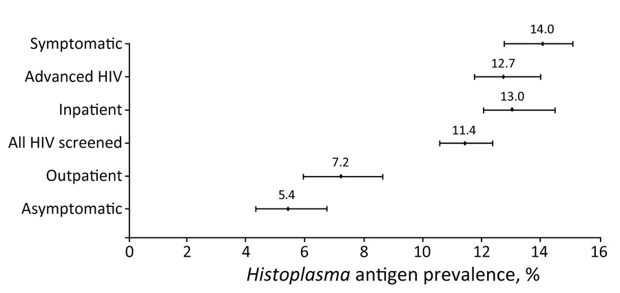
Figure 3
Figure 3. Forest plot of Histoplasma antigen prevalence among subgroups of interest in systematic review of prevalence of Histoplasma antigenuria in persons with HIV in Latin America and Africa. Error bars indicate 95% CIs.
Sekar P, Hale G, Gakuru J, Meya DB, Boulware DR, Ellis J, et al. Systematic Review of Prevalence of Histoplasma Antigenuria in Persons with HIV in Latin America and Africa. Emerg Infect Dis. 2024;30(8):1523-1530. https://doi.org/10.3201/eid3008.231710

