Slide 1
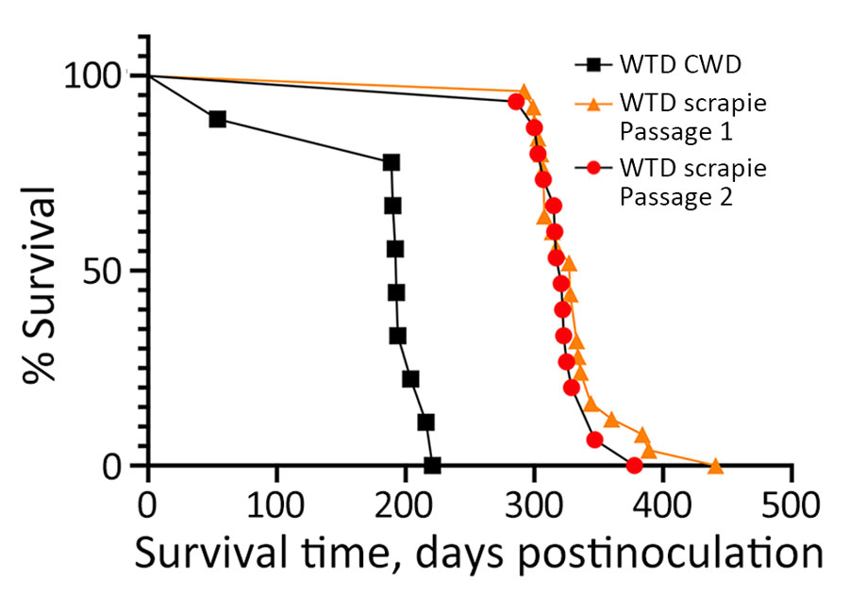
Figure 3
Figure 3. Survival curves for cervidized mice (Tg12) inoculated with brain material from white-tailed deer with CWD, passage 1 WTD scrapie agent, and passage 2 WTD scrapie agent in study of scrapie versus CWD in white-tailed deer. Incubation periods of mice inoculated with WTD scrapie agent were similar, whereas those inoculated with CWD were significantly shorter. CWD, chronic wasting disease; WTD, white-tailed deer.
Lambert ZJ, Bian J, Cassmann ED, Greenlee M, Greenlee JJ. Scrapie versus Chronic Wasting Disease in White-Tailed Deer. Emerg Infect Dis. 2024;30(8):1651-1659. https://doi.org/10.3201/eid3008.240007

