Slide 1
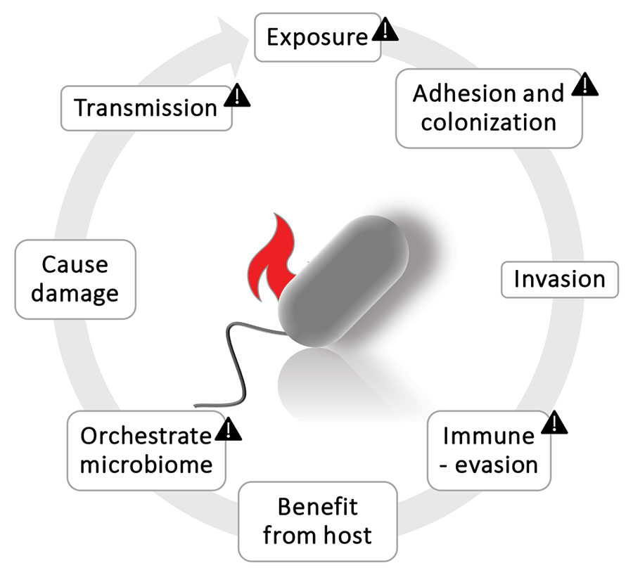
Figure 1
Figure 1. Cycle of pathogen actions. Triangles indicate pathogenic potentials for archaea. The other actions still require attention and strategic research. Figure created with BioRender (https://www.biorender.com).
Duller S, Moissl-Eichinger C. Archaea in the Human Microbiome and Potential Effects on Human Infectious Disease. Emerg Infect Dis. 2024;30(8):1505-1513. https://doi.org/10.3201/eid3008.240181

