Slide 1
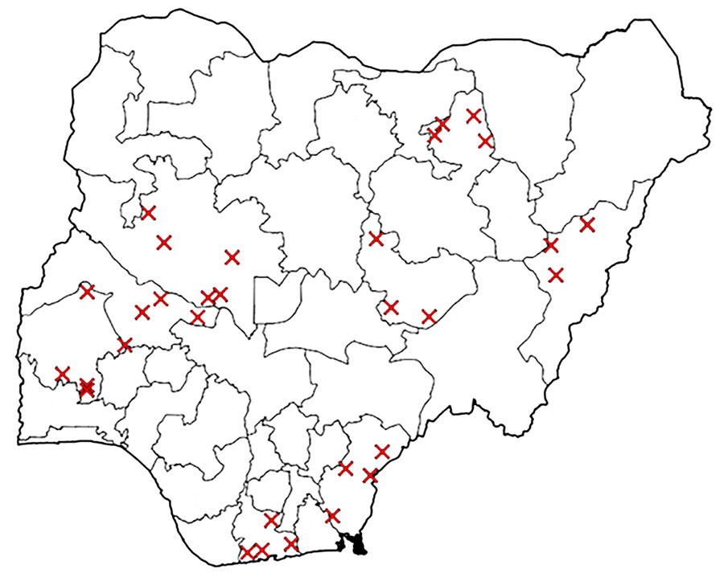
Figure 3
Figure 3. SITAware public health and event management system output example showing map within Situational Awareness Report indicating local government areas (districts) affected by an incident.
Elston J, Eteng W, Ihekweazu C, Oliver I, Aniaku E, Abubakar A, et al. Development and Implementation of a Public Health Event Management System, Nigeria, 2018–2024. Emerg Infect Dis. 2025;31(1):4-13. https://doi.org/10.3201/eid3101.240379

