Slide 1
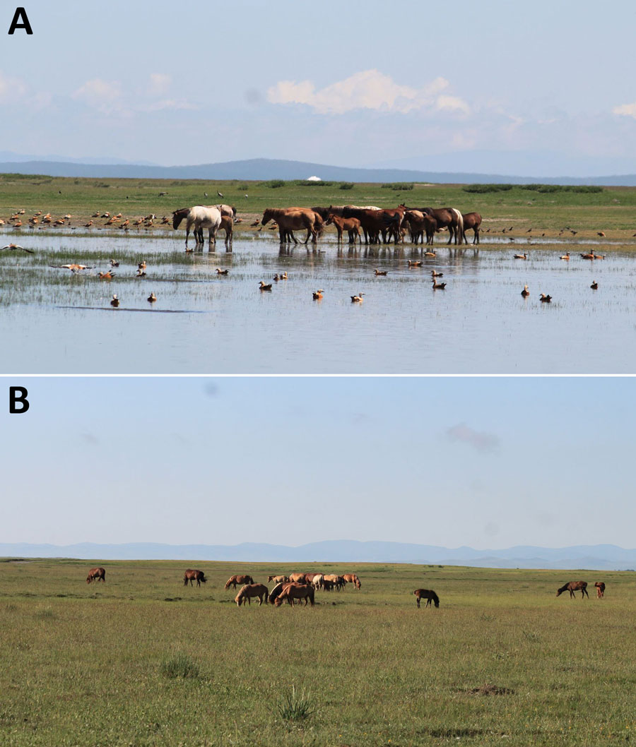
Figure 2
Figure 2. Typical ecosystems of sampling sites for study of influenza A(H5N1) spillover infections in horses, Mongolia. A) Arkangai Province, characterized by large wetlands. B) Bulgan Province, characterized by dry areas.
Damdinjav B, Raveendran S, Mojsiejczuk L, Ankhanbaatar U, Yang J, Sadeyen J, et al. Evidence of Influenza A(H5N1) Spillover Infections in Horses, Mongolia. Emerg Infect Dis. 2025;31(1):183-185. https://doi.org/10.3201/eid3101.241266

