Slide 1
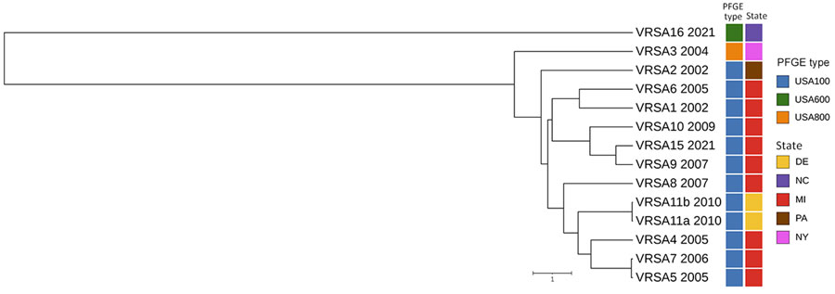
Figure
Figure. Whole-genome multilocus sequence typing for identification and characterization of VRSA, North Carolina, USA, 2021. Unweighted pair group method with arithmetic mean dendrogram shows the relationship of VRSA16 and previously sequenced VRSA genomes from US patients; sequence data for VRSA 12 (CC5/PFGE type unknown), VRSA 13 (CC30/USA1100), and VRSA 14 (CC5/USA100) were not available. Date of isolation (year), PFGE type (also known as USA type), and geographic location of each VRSA isolate are indicated. Scale bar indicates the whole-genome multilocus sequence typing allelic distance. PFGE, pulsed-field gel electrophoresis; VRSA, vancomycin-resistant Staphylococcus aureus.
MacFarquhar JK, Bajpai A, Fisher T, Barr C, Kent AG, McKay SL, et al. Identification and Characterization of Vancomycin-Resistant Staphylococcus aureus CC45/USA600, North Carolina, USA, 2021. Emerg Infect Dis. 2025;31(1):194-196. https://doi.org/10.3201/eid3101.241573

