Slide 1
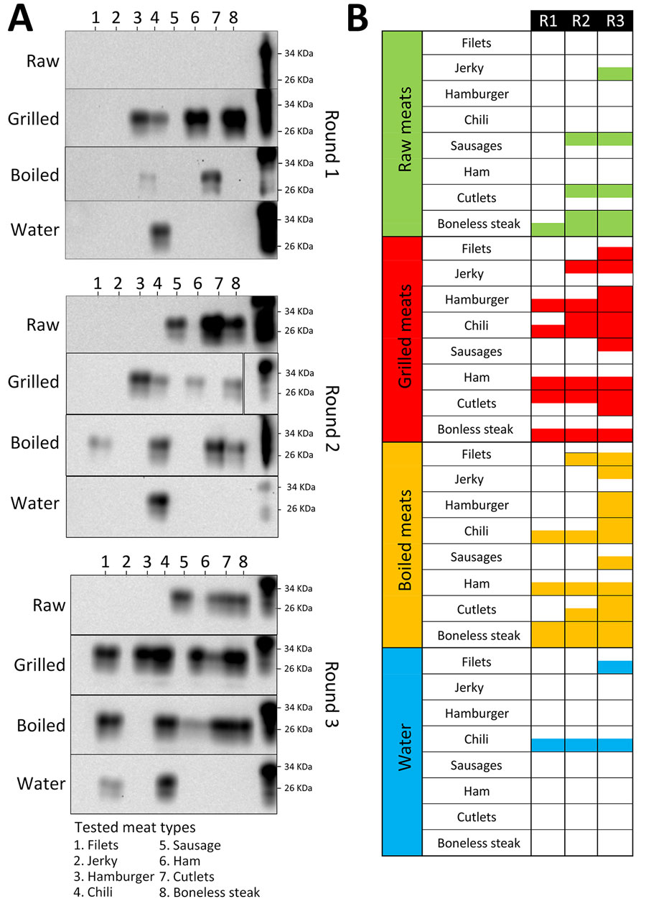
Figure 2
Figure 2. Western blot of PMCA used for detection of chronic wasting disease prions in raw, processed, and cooked elk meat. A) Representative PMCA data of the different samples tested. The panels depict the results obtained in 3 PMCA rounds of 1 of the replicates conducted in this analysis. All samples were treated with proteinase K, except for PrPC that was used as a control for antibody activity and electrophoretic mobility. Numbers at the right depict molecular weight markers. B) Summary of the PMCA detection data in both replicates for raw, grilled, and boiled meats and for the water used in the boiling process. PMCA, protein misfolding cyclic amplification; PrPC, cellular prion protein; R, round.
Benavente R, Brydon F, Bravo-Risi F, Soto P, Reed J, Lockwood M, et al. Detection of Chronic Wasting Disease Prions in Raw, Processed, and Cooked Elk Meat, Texas, USA. Emerg Infect Dis. 2025;31(2):363-367. https://doi.org/10.3201/eid3102.240906

