Slide 1
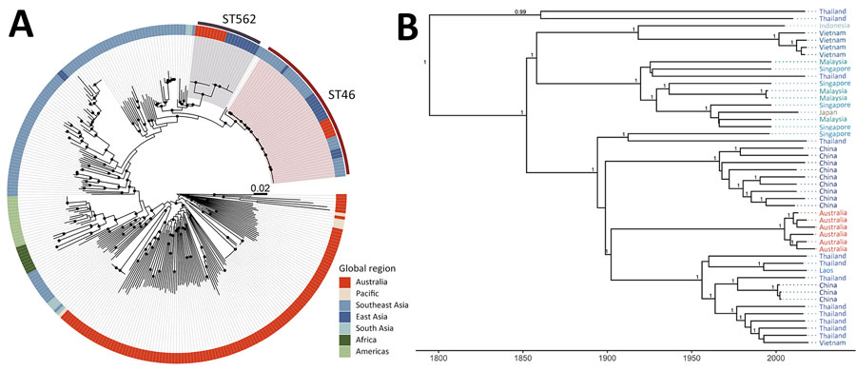
Figure
Figure. Phylogenies of Burkholderia pseudomallei ST46 shown in an investigation of B. pseudomallei ST46 transmission from Asia to Australia. A) Midpoint-rooted maximum-likelihood global phylogeny; B) maximum clade credibility tree. Trees include genomes collected as part of the Darwin Prospective Melioidosis Study in Darwin, Northern Territory, Australia, and others available in public sources (Appendix 1 Table). Black circles indicate nodes with an approximate likelihood ratio &gt;95 and ultrafast bootstrap &gt;95. Labels indicate nodes with posterior support &gt;0.8. ST, sequence type.
Meumann EM, Kaestli M, Webb JR, Rigas V, Woerle C, Mayo M, et al. Burkholderia pseudomallei Sequence Type 46 Transmission from Asia to Australia. Emerg Infect Dis. 2025;31(2):394-397. https://doi.org/10.3201/eid3102.241385

