Slide 1
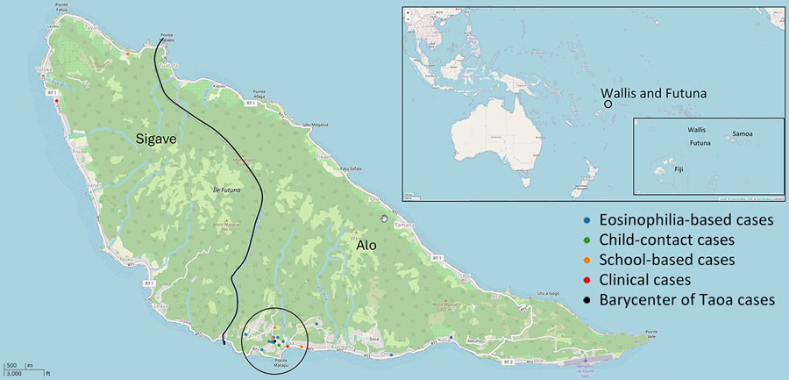
Figure 2
Figure 2. Geolocation of lymphatic filariasis cases detected in Futuna during October 2023–June 2024 and barycenter of Taoa cases. Kingdoms of Alo and Sigave are indicated. Inset maps show location of Wallis and Futuna in South Pacific.
Couteaux C, Demaneuf T, Bien L, Munoz M, Worms B, Chésimar S, et al. Postelimination Cluster of Lymphatic Filariasis, Futuna, 2024. Emerg Infect Dis. 2025;31(3):488-496. https://doi.org/10.3201/eid3103.241317

