Slide 1
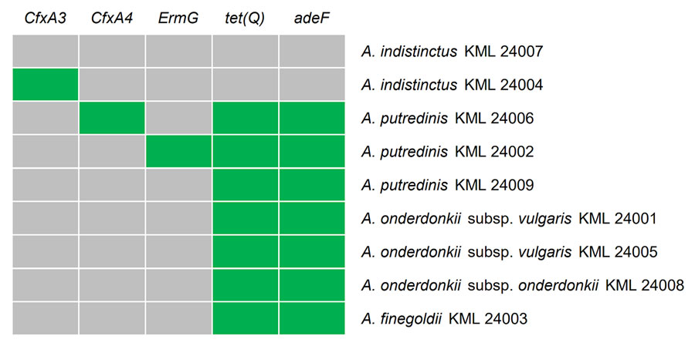
Figure 3
Figure 3. Heatmap representing distribution of antimicrobial resistance genes in Alistipes strains in study of Alistipes bacteremia in a tertiary care center, Japan, 2016–2023. Horizontal axis shows resistance genes; vertical axis shows strains. Gray cells indicate the absence of a resistance gene, and green cells indicate its presence.
Watanabe N, Watari T, Hosokawa N, Otsuka Y. Alistipes Bacteremia in Older Patients with Digestive and Cancer Comorbidities, Japan, 2016–2023. Emerg Infect Dis. 2025;31(4):652-661. https://doi.org/10.3201/eid3104.241284

