Slide 1
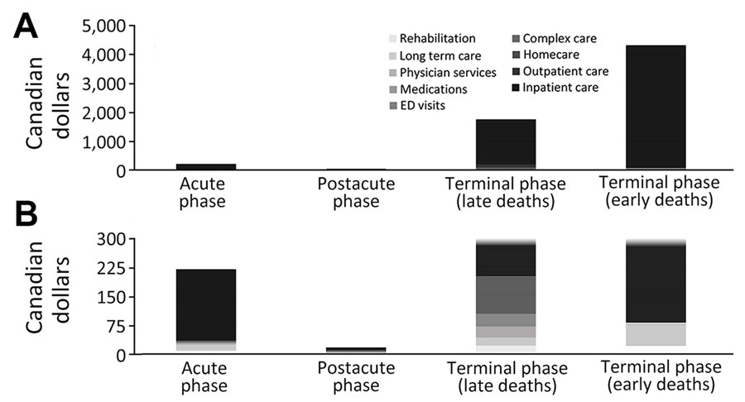
Figure 1
Figure 1. Source of COVID-19–attributable healthcare costs (2023 Canadian dollars), standardized to 10 days by phases-of-care, Ontario, Canada. Cost categories are displayed by phase of care. A) Full data; B) data truncated at $300 to improve visualization of the postacute-phase costs. ED, emergency department
Sander B, Mishra S, Swayze S, Sahakyan Y, Duchen R, Quinn K, et al. Population-Based Matched Cohort Study of COVID-19 Healthcare Costs, Ontario, Canada. Emerg Infect Dis. 2025;31(4):710-719. https://doi.org/10.3201/eid3104.241463

