Slide 1
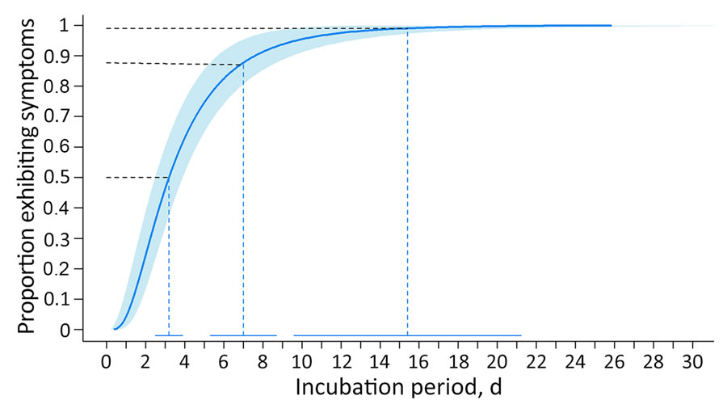
Figure 3
Figure 3. Estimated cumulative distribution of incubation period for Oropouche virus disease among 97 probable and confirmed travel-associated cases, 2024–2025. Solid blue line represents the estimated log-normal cumulative distribution function; shaded area represents 95% CI. Dashed lines correspond to the 50th and 99th quantiles, in addition to the proportion of patients that experienced symptoms within 1 week (88th quantile). The solid horizontal lines at bottom represent the 95% CIs for the quantiles.
Guagliardo SJ, Martin S, Gould CV, Sutter R, Jacobs D, O’Laughlin K, et al. Estimation of Incubation Period for Oropouche Virus Disease among Travel-Associated Cases, 2024–2025. Emerg Infect Dis. 2025;31(7):1337-1343. https://doi.org/10.3201/eid3107.250468

