Slide 1
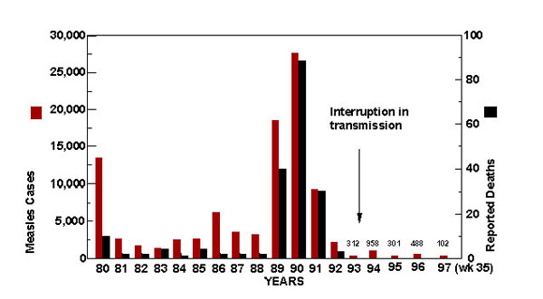
Figure 1
Figure 1.&nbsp;Incidence of U.S. measles cases and measles deaths between 1980 and 1997. Total number of measles cases for years 1993–1997 (week 35) are indicated above each bar.
Bellini WJ, Rota PA. Genetic Diversity of Wild-Type Measles Viruses: Implications for Global Measles Elimination Programs. Emerg Infect Dis. 1998;4(1):29-34. https://doi.org/10.3201/eid0401.980105

