Slide 1
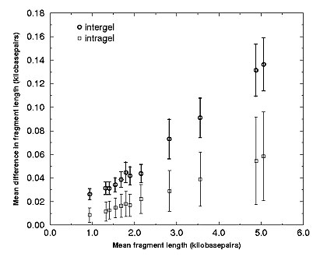
Figure 2
Figure 2.&nbsp;Means and two standard errors of the mean error bars for pairwise comparisons among 116 12-banded H37Rv lanes show that error is consistently larger when comparing lanes between gels than when comparing lanes from the same gel. The x-axis corresponds to w(b), and the y-axis to d(b), as presented in the text. It is evident that error is proportional to fragment length in the range of fragment lengths found in H37Rv. The data exhibit 2% to 3% error for between gel comparisons, but only approximately 1% error on average for within gel comparisons.
Salamon H, Segal MR, Ponce de Leon A, Small PM. Accommodating Error Analysis in Comparison and Clustering of Molecular Fingerprints. Emerg Infect Dis. 1998;4(2):159-168. https://doi.org/10.3201/eid0402.980203

