Slide 1
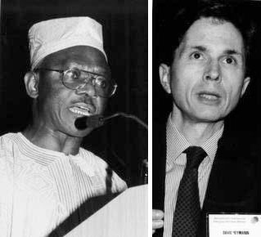
Figure 2
Figure 2.&nbsp;Thomas Nchinda, David Heymann; World Health Organization, Geneva, Switzerland.
Relman DA. Detection and Identification of Previously Unrecognized Microbial Pathogens. Emerg Infect Dis. 1998;4(3):382-389. https://doi.org/10.3201/eid0403.980310

