Slide 1
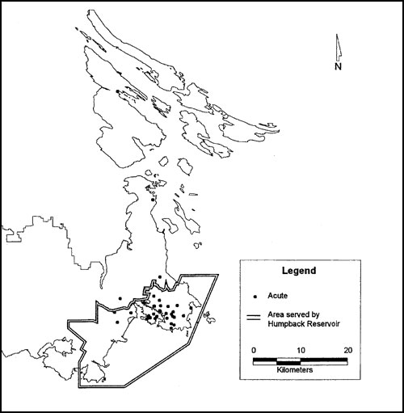
Figure 4
Figure 4.&nbsp;Geographic distribution of the residences of women screened during pregnancy and classified as having acute cases of toxoplasmosis (n = 36).
Eng SB, Werker DH, King AS, Marion SA, Bell A, Issac-Renton JL, et al. Computer-Generated Dot Maps as an Epidemiologic Tool: Investigating an Outbreak of Toxoplasmosis. Emerg Infect Dis. 1999;5(6):815-819. https://doi.org/10.3201/eid0506.990613

