Slide 1
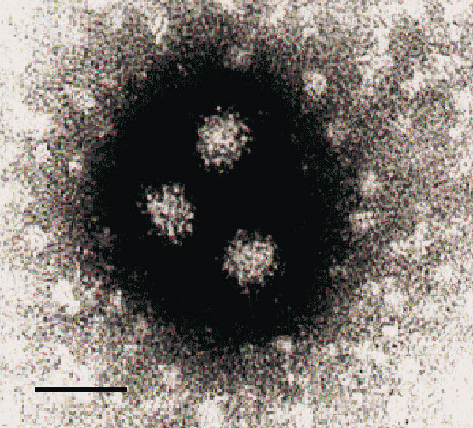
Figure 3
Figure 3.&nbsp;Electron microscopy showing NLV particles in a calf herd sample (CH176), negatively stained with 2% K-PTA, pH 7.0. Bar = 50nm.
van der Poel WH, Vinjé J, van der Heide R, Herrera M, Vivo A, Koopmans M. Norwalk-Like Calicivirus Genes in Farm Animals. Emerg Infect Dis. 2000;6(1):36-41. https://doi.org/10.3201/eid0601.000106

