Slide 1
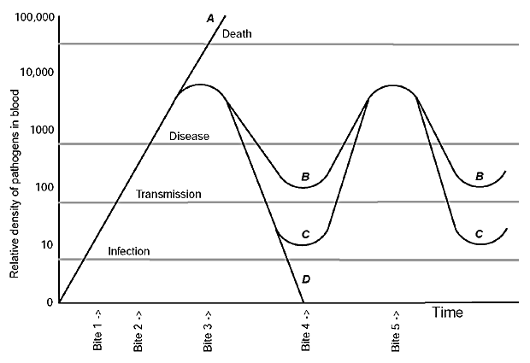
Figure 1
Figure 1.&nbsp;Relative densities of a vector-borne pathogen in the blood of four hosts, A-D. The gray horizontal lines represent the lower thresholds for the persistence of infection, transmission to a new vector, symptomatic disease in the host, and death of the host. In host A, overwhelming infection causes death. In hosts B and C, there is antigenic variation of the pathogen; B differs from C in the continuing likelihood of transmission even during periods of no or little illness. In case C, the host remains infected but is not infectious between relapses of high-density parasitemia and illness. In host D, the pathogen is cleared from the blood by the immune system. The relative density of the pathogens in the blood is on the y axis. If the arthropod vector of the infection fed on the four hosts at different times, the following outcomes would be observed: a bite at time 1 would not result in transmission because the density of pathogens in the blood was insufficient for uptake and establishment of the pathogen in the vector. At times 2 or 3, the disease agent is transmitted to the biting arthropod, although the hosts bitten at time 2 are not yet ill. At time 3, the infection worsens, in case A in the absence of an effective immune response. In cases B-D, the infection peaks as neutralizing antibodies to the infecting serotype appear in the blood at time 3. An arthropod taking a blood meal at time 4 could acquire the infection from host B but not from hosts C or D. In case D, the infection has been cleared by time 4. At time 5, both B and C could transmit the pathogens again and both have a relapse of illness as the result of the proliferation of a new serotype. The figure is modified from a figure by Turner (7).
Barbour AG, Restrepo BI. Antigenic Variation in Vector-Borne Pathogens. Emerg Infect Dis. 2000;6(5):449-457. https://doi.org/10.3201/eid0605.000502

