Slide 1
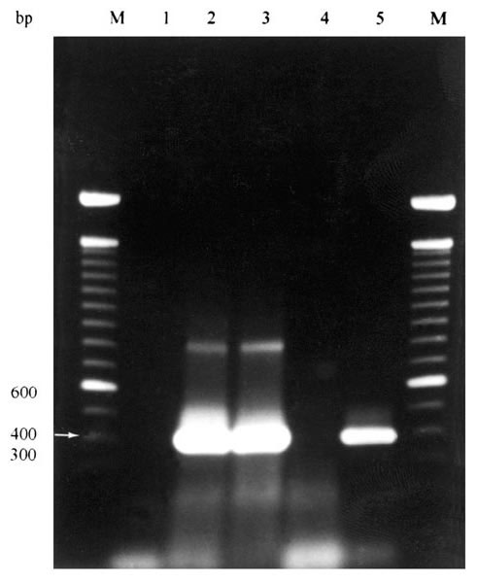
Figure
Figure.&nbsp;Agarose gel electrophoresis of results of PCR amplification of Ehrlichia chaffeensis nss rRNA gene from whole blood samples of coyotes numbers 9-11.* Lane 1= negative control (no DNA); Lane 2= coyote 9 (+); Lane 3= coyote 10 (+); Lane 4= coyote 11 (-); Lane 5 = positive control (E. chaffeensis-infected DH82 cells). M = 100-bp DNA ladder (Life Technologies, Rockville, MD).* * Ehrlichia forward primer ECC (5'-AGAACGAACGCTGGCGGCAAGC-3') and Ehrlichia reverse primer ECB (5'-CGTATTACCGCGGCTGCTGGCA-3') amplified all Ehrlichia spp (12,18). These reactions (50 l) contained 10 l of template DNA in 10 mM Tris-Cl (pH 8.3), 0.2 mM each deoxynucleoside triphosphate (dNTP), 2 mM MgCl2, 50 mM KCl, 0.5 m each primer, and 1.25 U of Taq DNA polymerase (Promega Corporation, Madison, WI). A hot-start PCR was used in which each enzyme was added to reactions after an initial 3-min denaturation step at 94°C. Reactions consisted of 30 cycles of denaturation at 94°C for 1 min, annealing at 65°C for 2 min, and extension at 72°C for 2 min. Products of this reaction were used as template with species-specific primer sets for three nested reactions. Primers HE1 (5'-CAATTGCTTATAACCTTTTGGTTATAAAT-3') and HE3 (5'-TATAGGTACCGTCATTATCTTCCCTAT-3') (17) were used for E. chaffeensis-specific amplifications. Primers ECAN5 (5'-CAATTATTTATAGCCTCTGGCTATAGGA-3') (12,13) and HE3 were used for E. canis-specific amplifications, and primers EE5 (5'-(CAATTCCTAAATAGTCTCTGACTATTTAG-3') (this study) and HE3 were used for E. ewingii-specific amplifications. Reactions (50 l) contained 10 l of the reaction product with ECC and ECB primers as template, and the remaining reaction components as above. A hot-start PCR was used in which the enzyme was added to reactions after an initial 3-min denaturation step at 94°C. Reactions with species-specific primers were in two stages. The first consisted of three cycles of denaturation at 94°C for 1 min, annealing at 55oC for 2 min, and extension at 72°C for 1.5 min. The second consisted of 37 cycles of denaturation at 92°C for 1 min, annealing at 55°C for 2 min, and extension at 72°C for 1.5 min. Distilled, deionized water served as a negative control. Positive control DNA samples were purified from E. chaffeensis-infected DH82 cells, blood from a dog experimentally infected with E. canis, and diluted general primer PCR reactions of synovial fluid from a dog experimentally infected with E. ewingii. To prevent contamination of samples, DNA purification, PCR master mix assembly, and amplifications were performed in separate rooms. Positive displacement pipetters and aerosol-free pipette tips were also used as further precautions.
Kocan A, Levesque GC, Whitworth LC, Murphy GL, Ewing SA, Barker RW. Naturally Occurring Ehrlichia chaffeensis Infection in Coyotes from Oklahoma. Emerg Infect Dis. 2000;6(5):477-480. https://doi.org/10.3201/eid0605.000505

