Slide 1
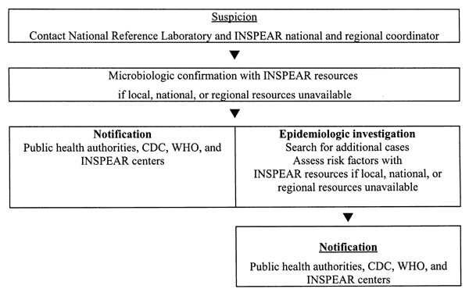
Figure
Figure.&nbsp;Functioning of the early warning system.
Richet HM, Mohammed J, McDonald LC, Jarvis WR. Building Communication Networks: International Network for the Study and Prevention of Emerging Antimicrobial Resistance (INSPEAR). Emerg Infect Dis. 2001;7(2):319-322. https://doi.org/10.3201/eid0702.700319

