Slide 1
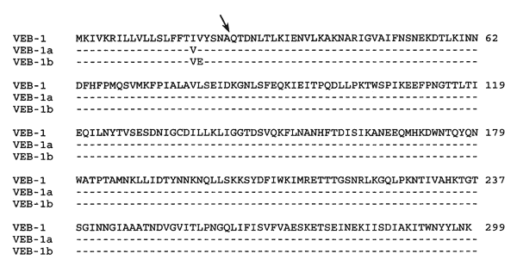
Figure
Figure. . Comparison of the amino acid sequence of VEB-1, VEB-1a, and VEB-1b beta-lactamases from Pseudomonas aeruginosa JES from Thailand and KU-1 and KU-2 from Kuwait. Dashed lines indicate identical amino acids. Arrow indicates position of the putative cleavage site of the peptide leader. Numbering is according to Ambler designation (12).
Poirel L, Rotimi VO, Mokaddas EM, Karim A, Nordmann P. VEB-1-like Extended-Spectrum ß-Lactamases in Pseudomonas aeruginosa, Kuwait. Emerg Infect Dis. 2001;7(3):468-470. https://doi.org/10.3201/eid0703.017322

