Slide 1
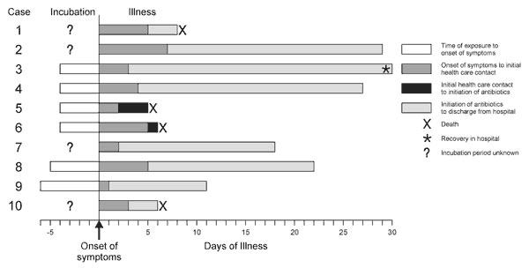
Figure 8
Figure 8.&nbsp;Timeline of 10 cases of inhalational anthrax in relation to onset of symptoms, October through November 2001.
Jernigan JA, Stephens DS, Ashford DA, Omenaca C, Topiel MS, Galbraith M, et al. Bioterrorism-Related Inhalational Anthrax: The First 10 Cases Reported in the United States. Emerg Infect Dis. 2001;7(6):933-944. https://doi.org/10.3201/eid0706.010604

