Slide 1
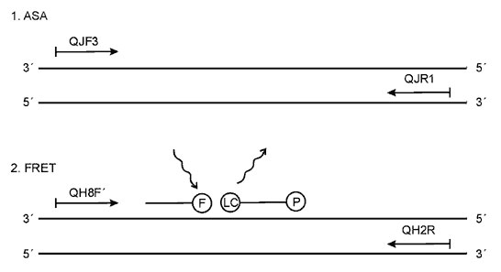
Figure 3
Figure 3.&nbsp;Schematic structure of the prn1 gene, showing the position of the primers used in the allele-specific amplification assay (1.), and the primers and probes used in the fluorescence resonance energy transfer probe assay (2.). Proportions of the gene are not drawn to scale. F = fluorescein; LC = LC red 640; and P = phosphate.
Mäkinen J, Viljanen MK, Mertsola J, Arvilommi H, He Q. Rapid Identification of Bordetella pertussis Pertactin Gene Variants Using LightCycler Real-Time Polymerase Chain Reaction Combined with Melting Curve Analysis and Gel Electrophoresis. Emerg Infect Dis. 2001;7(6):952-958. https://doi.org/10.3201/eid0706.010606

