Slide 1
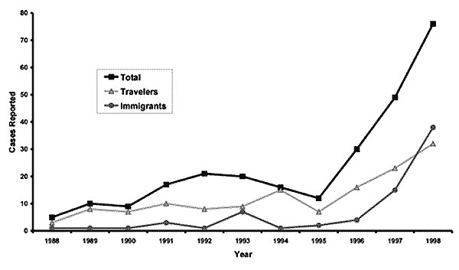
Figure
Figure.&nbsp;Reported cases of malaria by year, Minnesota, 1988-1998.
Seys SA, Bender JB. The Changing Epidemiology of Malaria in Minnesota. Emerg Infect Dis. 2001;7(6):993-995. https://doi.org/10.3201/eid0706.010612

