Slide 1
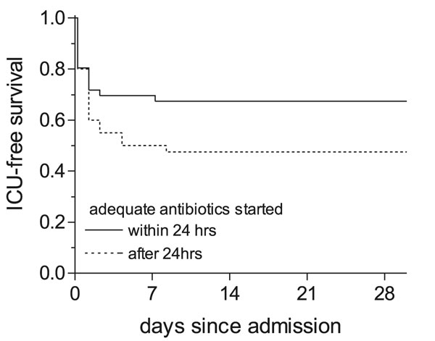
Figure 2
Figure 2.&nbsp;Kaplan-Meier curve for intensive care unit (ICU)–free survival. ICU-free survival for patients treated with adequate antibiotics within and &gt;24 h after admission.:___ adequate antibiotic therapy started within 24 h after admission (n=85); ----- adequate antibiotic therapy started &gt;24 h after admission (n=56).
Lettinga KD, Verbon A, Weverling G, Schellekens JF, Den Boer JW, Yzerman EP, et al. Legionnaires’ Disease at a Dutch Flower Show: Prognostic Factors and Impact of Therapy. Emerg Infect Dis. 2002;8(12):1448-1454. https://doi.org/10.3201/eid0812.020035

