Slide 1
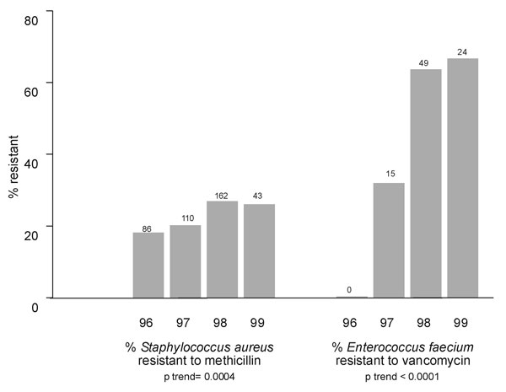
Figure 2
Figure 2.&nbsp;Increase in percentage of Staphylococcus aureus isolates resistant to methicillin and increase in percent of Enterococcus faecium resistant to vancomycin on a yearly basis from 1996 through the first quarter of 1999. Number of isolates per year, regardless of susceptibility, appears above each bar. Tests of trend showed significant increases in percent resistance for both organisms.
Huang SS, Labus BJ, Samuel MC, Wan DT, Reingold AL. Antibiotic Resistance Patterns of Bacterial Isolates from Blood in San Francisco County, California, 1996-1999. Emerg Infect Dis. 2002;8(2):195-201. https://doi.org/10.3201/eid0802.010102

