Slide 1
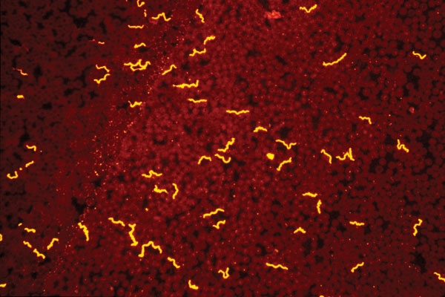
Figure 2
Figure 2.&nbsp;Borrelia hermsii visualized with an immunofluorescent stain in a thin blood smear of an experimentally infected mouse. Such recurrent, high densities of spirochetes circulating in the peripheral blood of small mammals allows for the acquisition of these bacteria by fast-feeding ticks that ingest a small volume of blood.
Schwan TG, Piesman J. Vector Interactions and Molecular Adaptations of Lyme Disease and Relapsing Fever Spirochetes Associated with Transmission by Ticks. Emerg Infect Dis. 2002;8(2):115-121. https://doi.org/10.3201/eid0802.010198

