Slide 1
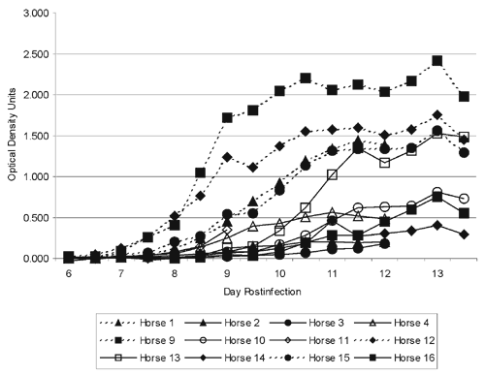
Figure 1
Figure 1.&nbsp;West Nile virus (WNV) Absorbance attributed to specific WNV antigen immuglobulin (Ig) M interaction in the West Nile Equine IgM Capture enzyme-linked immunosorbent assay (ELISA).
Bunning ML, Bowen RA, Cropp C, Sullivan KG, Davis BS, Komar N, et al. Experimental Infection of Horses with West Nile virus. Emerg Infect Dis. 2002;8(4):380-386. https://doi.org/10.3201/eid0804.010239

