Slide 1
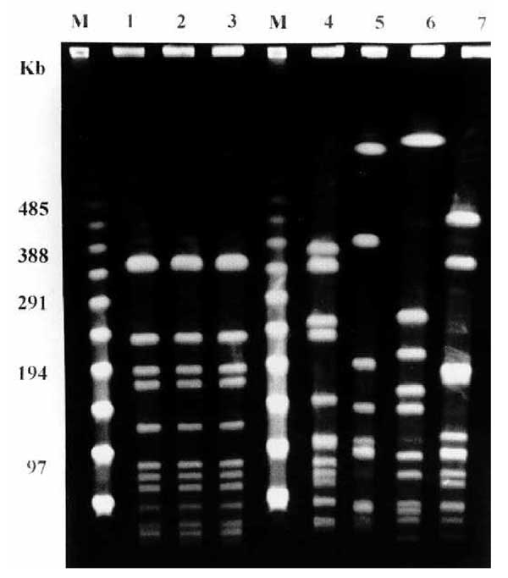
Figure
Figure. . Pulsed-field gel electrophoresis patterns of the three clinical isolates of levofloxacin-resistant Haemophilus influenzae from the case report (lanes 1 to 3) and four control cases of levofloxacin-susceptible H. influenzae biotype II strains isolated from the same geographic area (lanes 4 to 7). Lane 1: strain 32602 (blood); lane 2: strain 35102 (blood); lane 3: strain 35202 (bronchial aspirate); lane 4: pleural fluid isolate; lane 5: blood isolate; lane 6: pleural fluid isolate. M, molecular markers.
Bastida T, Pérez-Vázquez M, Campos J, Cortés-Lletget M, Román F, Tubau F, et al. Levofloxacin Treatment Failure in Haemophilus influenzae Pneumonia. Emerg Infect Dis. 2003;9(11):1475-1479. https://doi.org/10.3201/eid0911.030176

