Slide 1
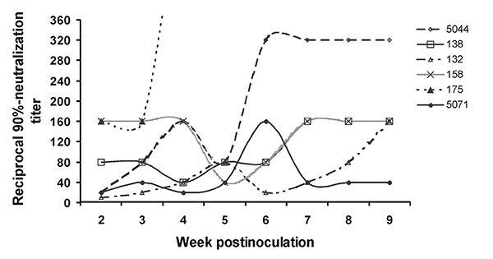
Figure 3
Figure 3.&nbsp;West Nile virus-neutralizing antibody response of six mosquito-exposed Rock Doves (pigeons). Rock Dove 175 reached a titer of 1:640 at 4 weeks postinoculation and then died of other causes.
Komar N, Langevin S, Hinten S, Nemeth NM, Edwards E, Hettler DL, et al. Experimental Infection of North American Birds with the New York 1999 Strain of West Nile Virus. Emerg Infect Dis. 2003;9(3):311-322. https://doi.org/10.3201/eid0903.020628

