Slide 1
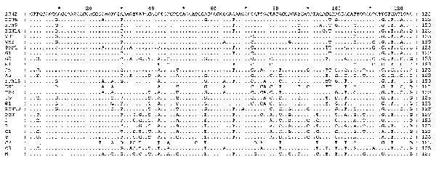
Figure 2
Figure 2.&nbsp;Nucleotide alignment of the amplified fragment within ORF2 from some representative isolates in this study with other Hepatitis E virus strains. Dots indicate sequence identities.
Clemente-Casares P, Pina S, Buti M, Jardi R, Martín M, Bofill-Mas S, et al. Hepatitis E Virus Epidemiology in Industrialized Countries. Emerg Infect Dis. 2003;9(4):449-454. https://doi.org/10.3201/eid0904.020351

