Slide 1
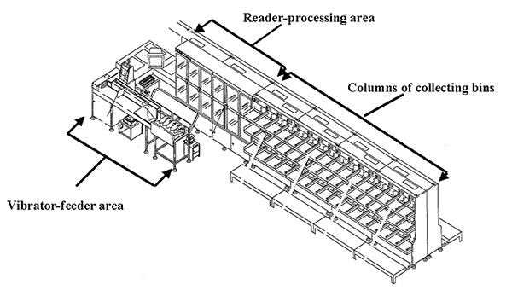
Figure 2
Figure 2.&nbsp;Diagram of a letter-sorting machine
Griffith KS, Mead PS, Armstrong GL, Painter JA, Kelley KA, Hoffmaster AR, et al. Bioterrorism-related Inhalational Anthrax in an Elderly Woman, Connecticut, 2001. Emerg Infect Dis. 2003;9(6):681-688. https://doi.org/10.3201/eid0906.020728

