Slide 1
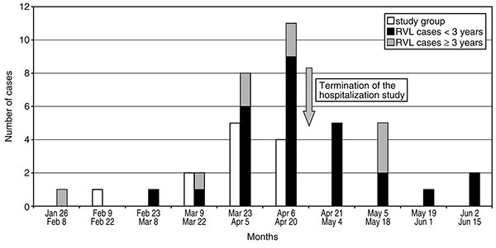
Figure 3
Figure 3.&nbsp;Biweekly distribution of virologically confirmed human metapneumovirus (HMPV) cases from the prospective pediatric study (study group) and from the general population as retrospectively identified in the Québec City Regional Virology Laboratory (RVL).
Boivin G, De Serres G, Côté S, Gilca R, Abed Y, Rochette L, et al. Human Metapneumovirus Infections in Hospitalized Children. Emerg Infect Dis. 2003;9(6):634-640. https://doi.org/10.3201/eid0906.030017

