Slide 1
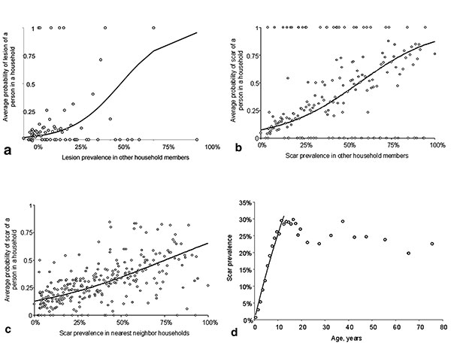
Figure
Figure.&nbsp;A, the average probability of having a lesion at different levels of lesion prevalence recorded among other members of the same household (open circles) and the unadjusted fit (solid line) from the logistic regression. B, the average probability of having a scar at different levels of scar prevalence recorded in other members of the same household (open circles) and the unadjusted fit (solid line) from the logistic regression. C, average probability of having a scar at different levels of scar prevalence in nearest neighbor households (open circles) and the unadjusted fit (solid line) from the logistic regression. D, force of infection, λ, can be estimated from the age-prevalence data, where the proportion, P, of persons with ACL at age a (where a is age at last birthday plus 0.5 years) is given by P(a) = 1-exp(-λa) (6). If one assumes that age-independent transmission started 12 years earlier (1), λ was estimated by maximum likelihood by using the observed age-prevalence data for children &lt;12 y of age.
Reithinger R, Mohsen M, Aadil K, Sidiqi M, Erasmus P, Coleman PG. Anthroponotic Cutaneous Leishmaniasis, Kabul, Afghanistan. Emerg Infect Dis. 2003;9(6):727-729. https://doi.org/10.3201/eid0906.030026

