Slide 1
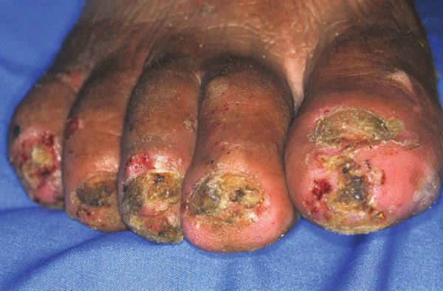
Figure 4
Figure 4.&nbsp;Right foot of a 50-year-old man. All nails have been lost. Embedded fleas have been manipulated by the patient, leaving innumerable sores. Desquamation and ulceration are merged. The skin tends to bleed where the stratum corneum is eroded.
Feldmeier H, Eisele M, Sabóia-Moura RC, Heukelbach J. Severe Tungiasis in Underprivileged Communities: Case Series from Brazil. Emerg Infect Dis. 2003;9(8):949-955. https://doi.org/10.3201/eid0908.030041

