Slide 1
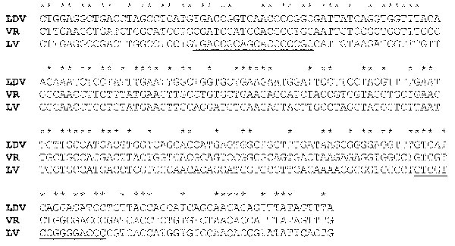
Figure 4
Figure 4.&nbsp;Nucleotide alignment of a segment of open reading frame (ORF) 1b of lactate dehydrogenase-elevating virus–P, porcine reproductive and respiratory syndrome virus VR-2332, and porcine reproductive and respiratory syndrome virus–Lelystad virus beginning at nucleotides 1169, 1165, and 1165, respectively. *Indicates identical nucleotides. Degenerate primer sets for polymerase chain reaction were previously made to the underlined segments (41).
Plagemann PG. Porcine Reproductive and Respiratory Syndrome Virus: Origin Hypothesis. Emerg Infect Dis. 2003;9(8):903-908. https://doi.org/10.3201/eid0908.030232

